Slide 1
Computer Architecture
Lab 5

Slide 2
MIPS Instruction Set Architecture

Slide 3
Introduction to MIPS
$S0
R16
$S1
R17
$S2
R18
$S3
R19
$S4
R20
$S5
R21
$S6
R22
$S7
R23

Slide 4
Data Transfer Instructions (load immediate and move)
s0 = R16
$s0 is destination register and 3 is an immediate value
li $s0,3
3
li $s1,5
$s1 is destination register and 5 is an immediate value
s1 = R17
5
move $s2, $s0
Copy the value in $s0 to $s2
s2
3

Slide 5
Arithmetic Instructions (Add, Add Immediate, subtract)
s1 = R17
$s1 is destination register that has the result of $s2+$s3
add $s1,$s2,$s3
5
addi $s1,$s2,100
$s1 is destination register that has the result of $s2+100
s2 = R18
2
sub $s1,$s2,$s3
$s1 is destination register that has the result of $s2-$s3
s3 = R19
3

Slide 6
Arithmetic Instructions (Multiply, Divide )
s1 = R17
$s1 is destination register that has the result of $s2*$s3
mul $s1,$s2,$s3
9
s2 = R18
6
$s1 is destination register that has the result of $s2*$s3
div $s1,$s2,$s3
s3 = R19
3
Notes:
Most of the Arithmetic instructions don't accept immediate value except the “addi” instruction

Slide 7
First Program in MIPS
s1 = R17
.globl main
.text
main:
li $s0,2
li $s1,3
li $s2,0
add $s2,$s0,$s1
li $v0,10
syscall
3
Start of the code
s2 = R18
2
s3 = R19
End of the code
5
Notes:
The instruction letters all small letters

Slide 8
How to Jump in the code
Conditional Branch
Unconditional Jump
bgt $S1,$S2,part1
j part1
part1:
add $S3,$S1,$S2
part1 :
add $S3,$S1,$S2
if($S1>$S2) jump in the code to part1 section
jump in the code to part1 section
Notes: We also have beq, bne, bgt, bge, blt, ble.

Slide 9
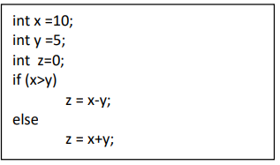
Problem 1
.globl main
.text
main:
li $s0, 10 → x=10
li $s1, 5 → y=5
li $s2, 0 → z=0
bgt $s0, $s1, part1 → if(x>y)
add $s2, $s0, $s1 → z = x+y;
j Exit
part1:
sub $s2, $s0, $s1 → z = x-y;
Exit:
li $v0, 10
syscall

Slide 10
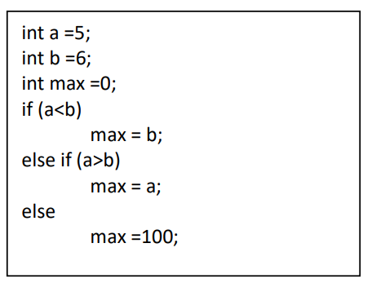
Problem 2
.globl main
.text
main:
li $s0, 5 → a=5
li $s1, 6 → b=6
li $s2, 0 → max=0
blt $s0, $s1, part1 → if (a<b)
bgt $s0, $s1, part2 →else if (a>b)
li $s2, 100 →else max = 100
j Exit
part1:
move $s2, $s1 → max = b
j Exit
part2:
move $s2, $s0 → max = a
Exit:
li $v0, 10
syscall

Slide 11
How to make loops
Comparison
Loop
if($S2 < $S3) $S1=1
else $S1=0
slt $S1,$S2,$S3
for (int i=1; i<=20; i++)
main:
li $s1, 1
loop: slti $t0, $s1, 21
beq $t0, $zero, Exit
addi $s1, $s1, 1
j loop
Exit:
if($S2 < 100) $S1=1
else $S1=0
slti $S1,$S2,100
Notes:
$t0 - $t9 Temporary variables to store the data.

Slide 12
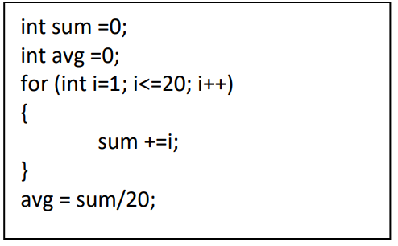
Problem 4
.globl main
.text
main:
li $s1, 1
li $t1, 20
loop: slti $t0, $s1, 21
beq $t0, $zero, Exit
add $s2, $s2, $s1
addi $s1, $s1, 1
j loop
Exit:
div $s3, $s2, $t1
li $v0, 10
syscall

Slide 13
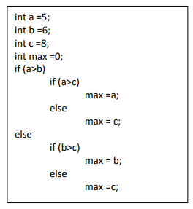
Problem 3

Slide 14
Problem 3
.globl main
.text
main:
li $s0, 5 → a=5
li $s1, 6 → b=6
li $s2, 8 → c=0
li $s3, 0 → max=0
bgt $s0, $s1, outerif → if (a>b)
blt $s1, $s2, innerif2 →else (a<b) or (a==b) and b<c
move $s3, $s1 →(b>c)
outerif:
bgt $s0, $s2, innerif1 → if (a>c)
j innerif2 →else
innerif1:
move $s3, $s0 → max=a
j Exit
innerif2:
move $s3, $s2 → max=c
j Exit
Exit:
li $v0, 10
syscall

Slide 15
